Slide 1

Module 0
Python Programming
Notes:
Guidelines
Use section headers to chunk content in your presentation.
Use the same style of section header throughout your presentation.
Keep your title to no more than 2 lines.

Slide 2
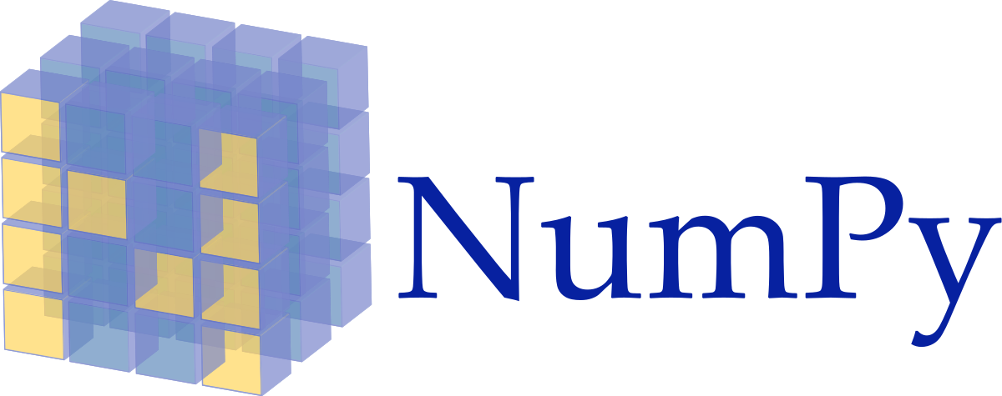
Python Basics
Notes:
Guidelines
Use a title slide at the beginning of your presentation. There are 9 variations of title slides to choose from.
If you will have a series of slideshows, we recommend using the same style of title slide for each presentation.
Keep your title to no more than 2 lines.
Do not change the font style or font size of the title or subtitle.

Slide 3
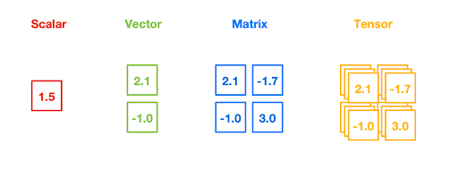
NumPy
Provides advanced features to store and operate big data sets.
Convention is to use the alias np
Allows the easy creation of multi-dimensional arrays

Slide 4
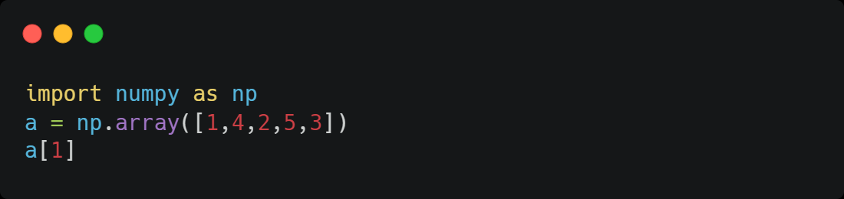
NumPy Arrays
Mutable objects similar to lists but more efficient computationally
4

Slide 5
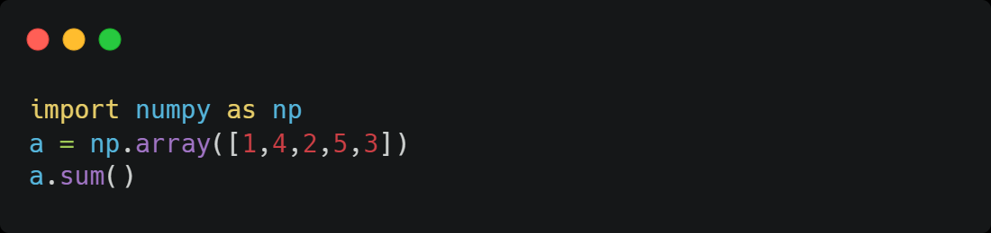
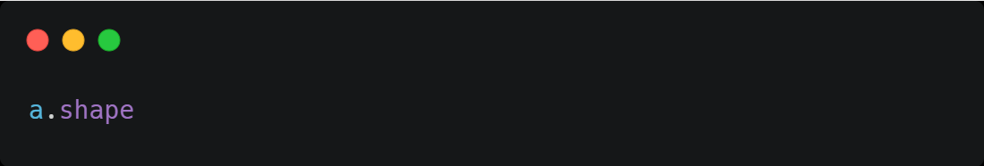
NumPy Arrays
Contain useful efficient methods and attributes
15
(5,)

Slide 6
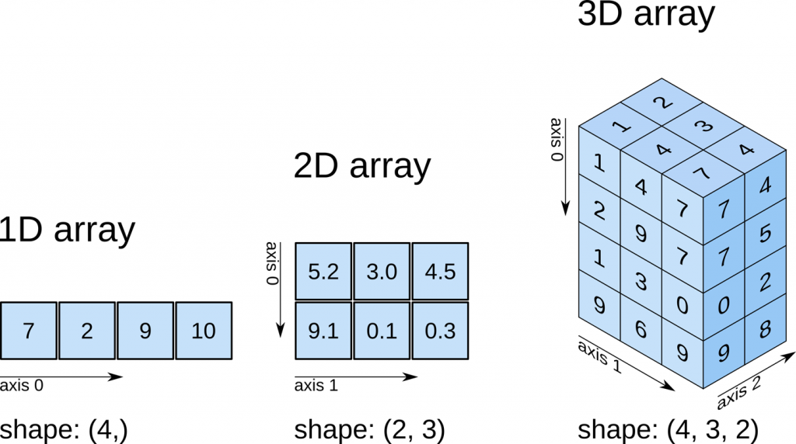
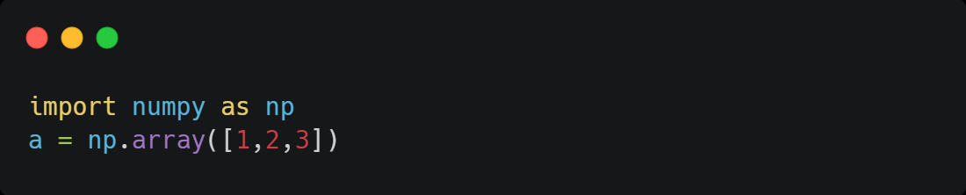

NumPy Vectors
Vectors are 1-dimensional objects (1D Array)

Slide 7
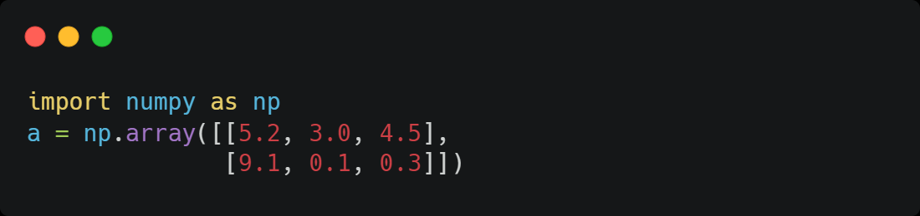
NumPy Matrices
Vectors are 2-dimensional objects (2D Array)

Slide 8
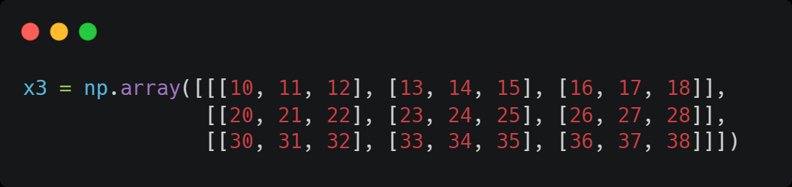
NumPy Tensors
Vectors are k-dimensional objects (kD Array)

Slide 9
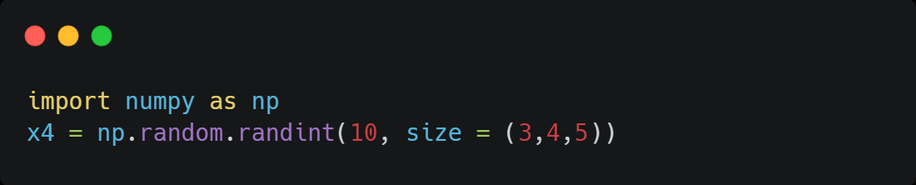
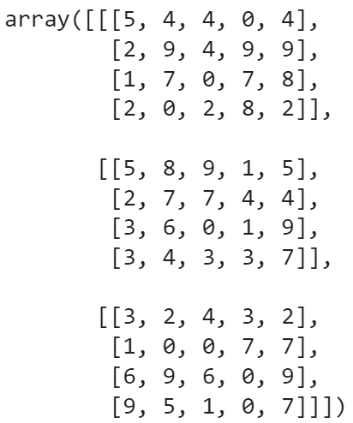
Generating Data with NumPy
You can generate arrays of any shape from different distributions

Slide 10
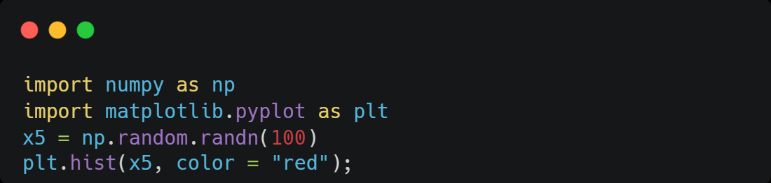
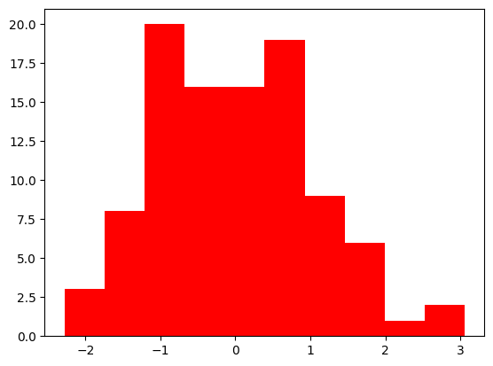
Generating Data with NumPy
You can generate arrays of any shape from different distributions
np.zeros()
np.ones()
np.full()

Slide 11

Python Basics
Notes:
Guidelines
Use a title slide at the beginning of your presentation. There are 9 variations of title slides to choose from.
If you will have a series of slideshows, we recommend using the same style of title slide for each presentation.
Keep your title to no more than 2 lines.
Do not change the font style or font size of the title or subtitle.

Slide 12
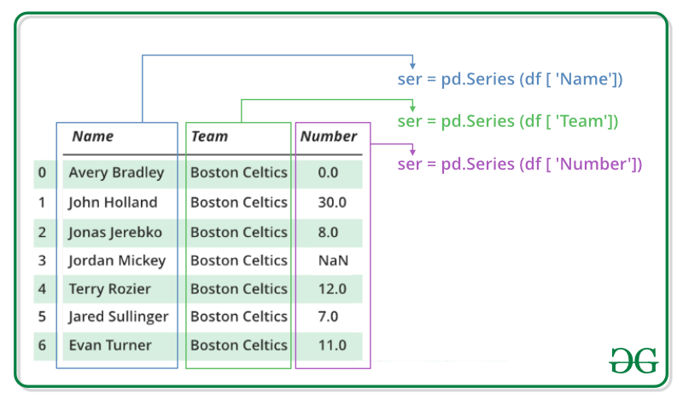
Pandas
Data analysis and manipulation tool.
Convention is to use the alias pd
Two main objects: Series and DataFrame

Slide 13
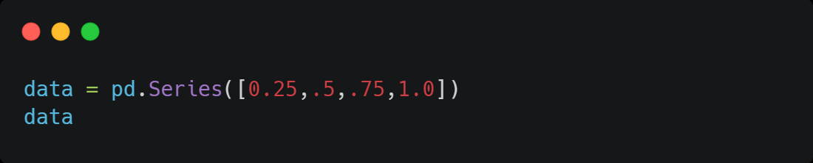

Pandas Series
Equivalent to NumPy 1D Array.
Contains an index
data.values
NumPy Array
data.index
Range Type

Slide 14
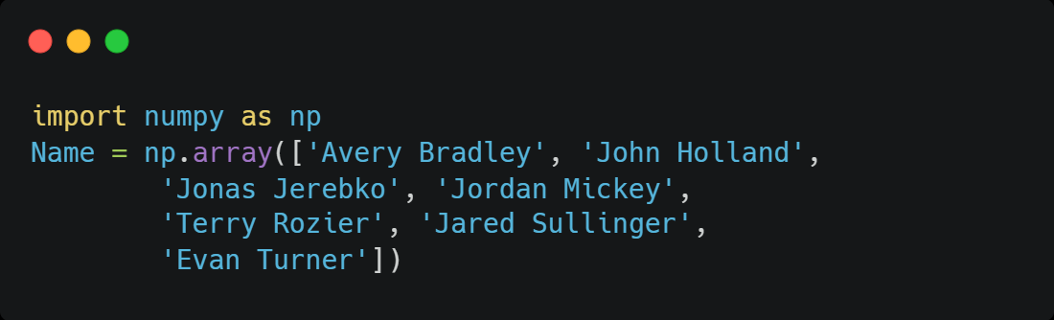
Pandas Series
Equivalent to NumPy 1D Array.
import pandas as pd
Name = pd.Series(Name)

Slide 15
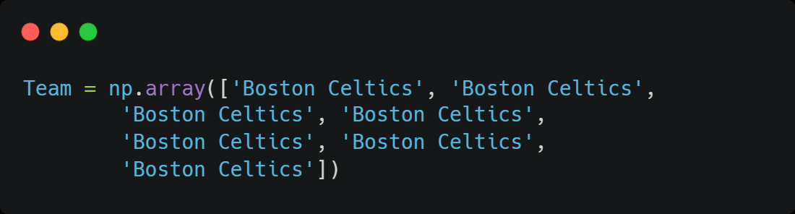
Pandas Series
Equivalent to NumPy 1D Array.
import pandas as pd
Team = pd.Series(Team)

Slide 16
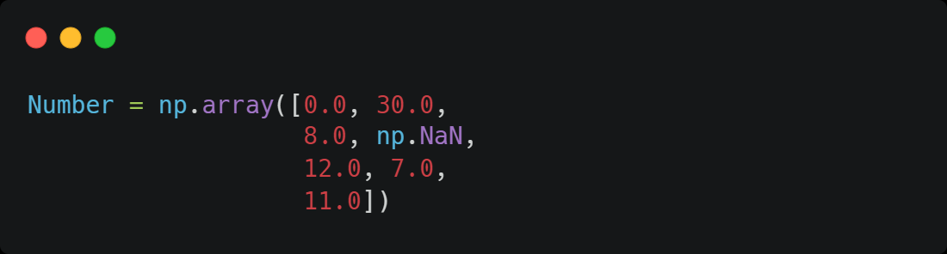
Pandas Series
Equivalent to NumPy 1D Array.
import pandas as pd
Number = pd.Series(Number)

Slide 17
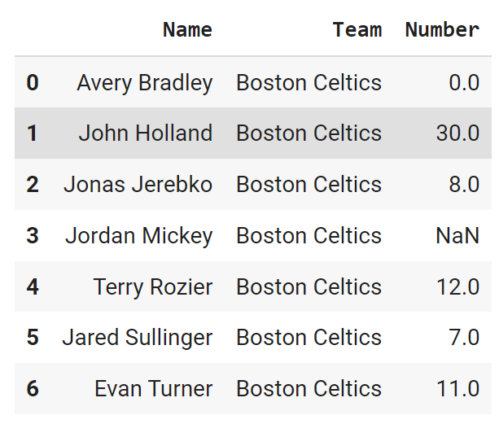
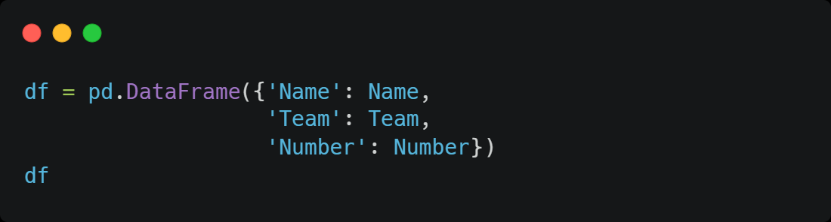
Pandas DataFrame
Equivalent to NumPy 2D Array.
Combines multiple pandas Series
Contains an index

Slide 18
Selecting Columns DataFrame
We can select columns in multiple ways
df["Name"]
df.Team
df.iloc[:,2]

Slide 19
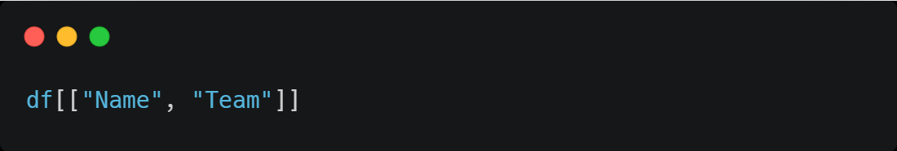
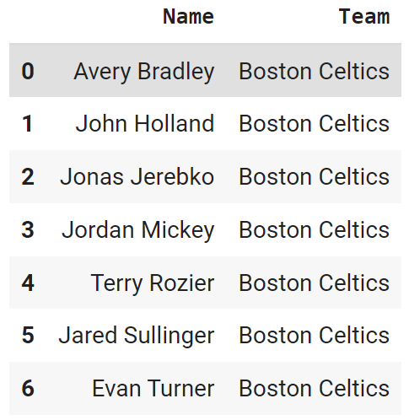
Pandas DataFrame
Selecting multiple columns

Slide 20
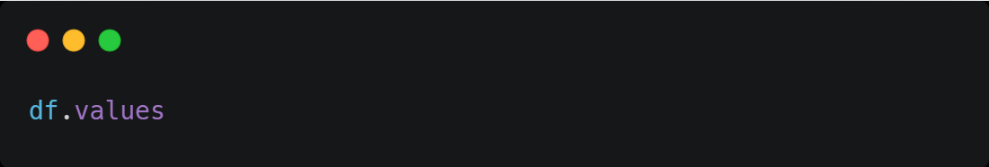
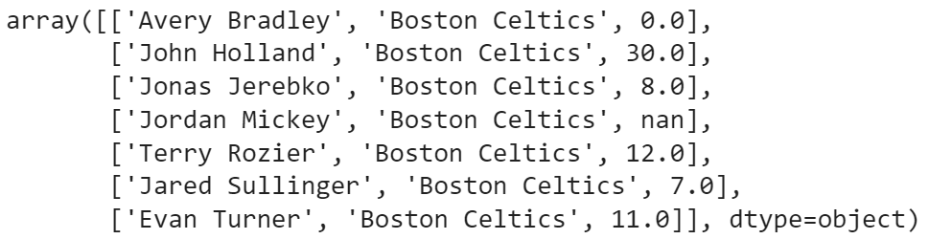
Pandas DataFrame
Converting Pandas DataFrame to NumPy

Slide 21
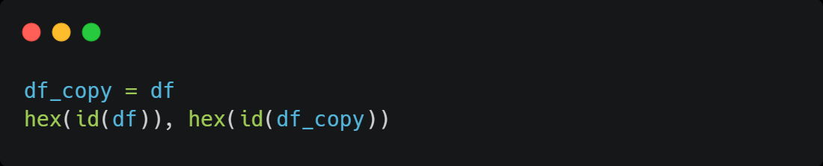
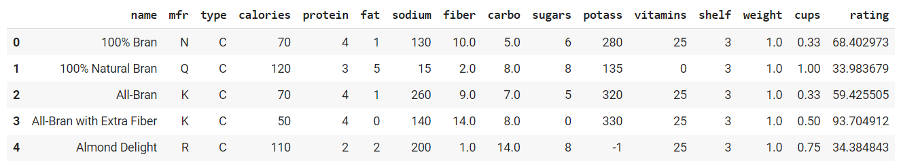
Recall: Identifiers as Pointers
Making a copy using = is NOT recommended
df
'0x7f592c28b850'
df_copy
'0x7f592c28b850'

Slide 22
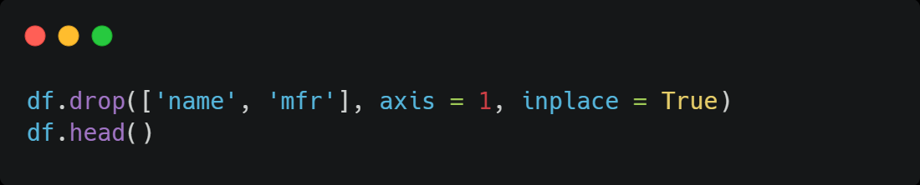
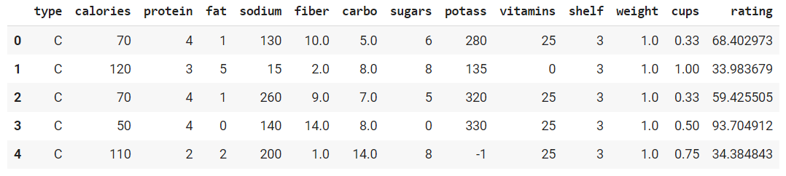
Removing Columns from DataFrame
The method .drop() can be used
df
'0x7f592c28b850'
df_copy
'0x7f592c28b850'

Slide 23
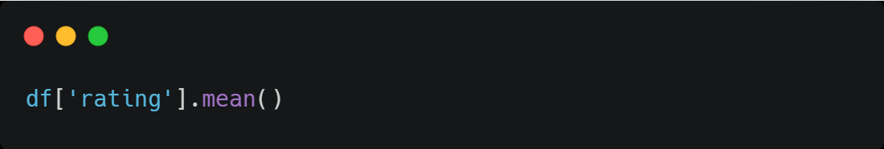
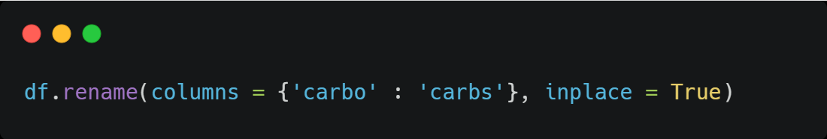
Useful Pandas Methods
Methods are useful, e.g.,
.describe()
.info()
.isnull.sum()
Methods are available for Series as well, e.g.,
.sum(),
.mean()
.value_counts()
42.66570498701299

Slide 24
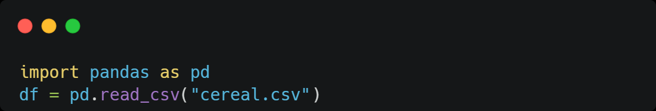
Reading Data
.csv data can be read using the .read_csv method
“/home/users/martinwg/cereal.csv”

